Slide 1

Serverless Image Processing
Group members :
ANUSHKA YADAV
MADHURAG TRIPATHI
ARPITA DWIVEDI
TUSHAR SHARMA

Slide 2


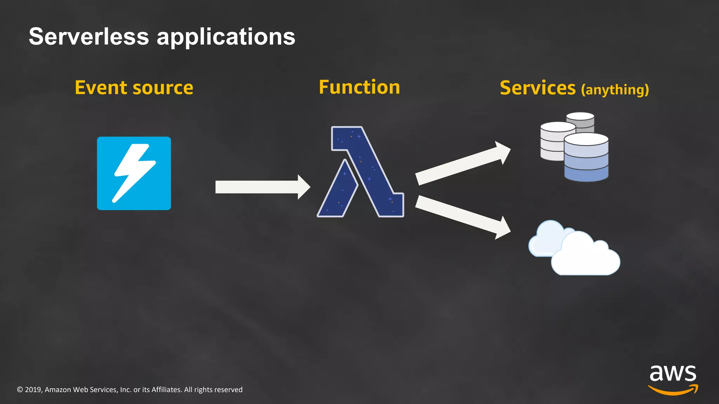
Introduction
Serverless Image Processing is a modern and efficient approach to handle image processing tasks without managing traditional server infrastructure. Amazon Web Services (AWS) offers a powerful combination of AWS Simple Storage Service (S3) and AWS Lambda, providing a scalable and cost-effective solution for image processing workflows.

Slide 3

Aws lamda:
AWS Lambda is an event-driven, serverless computing platform provided by Amazon as a part of Amazon Web Services. It is a computing service that runs code in response to events and automatically manages the computing resources required by that code. It was introduced on November 13, 2014.

Slide 4
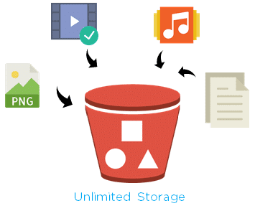
AWS S3 - The Scalable Storage Solution
Amazon S3 is a secure, durable, and highly scalable object storage service provided by AWS. It allows you to store and retrieve any amount of data at any time. For our image processing workflow, S3 plays a crucial role as the primary storage for the images. Lambda functions will be triggered by events on the S3 bucket, enabling us to process images on the fly.

Slide 5
Security and privacy :
Data Encryption: Ensure that both data in transit and at rest are encrypted. Use secure communication protocols like HTTPS for data transmission, and utilize encryption mechanisms provided by the serverless platform to safeguard data on storage.
Access Control: Implement strict access controls to limit who can access and modify your serverless functions. Utilize identity and access management (IAM) services to manage permissions effectively.
Image Sanitization: Before processing images, sanitize metadata and remove any potentially harmful content. Images can carry embedded malware or malicious code that could compromise the serverless environment.
Regular Security Audits: Conduct regular security assessments, penetration testing, and code reviews to identify and address potential vulnerabilities.

Slide 6
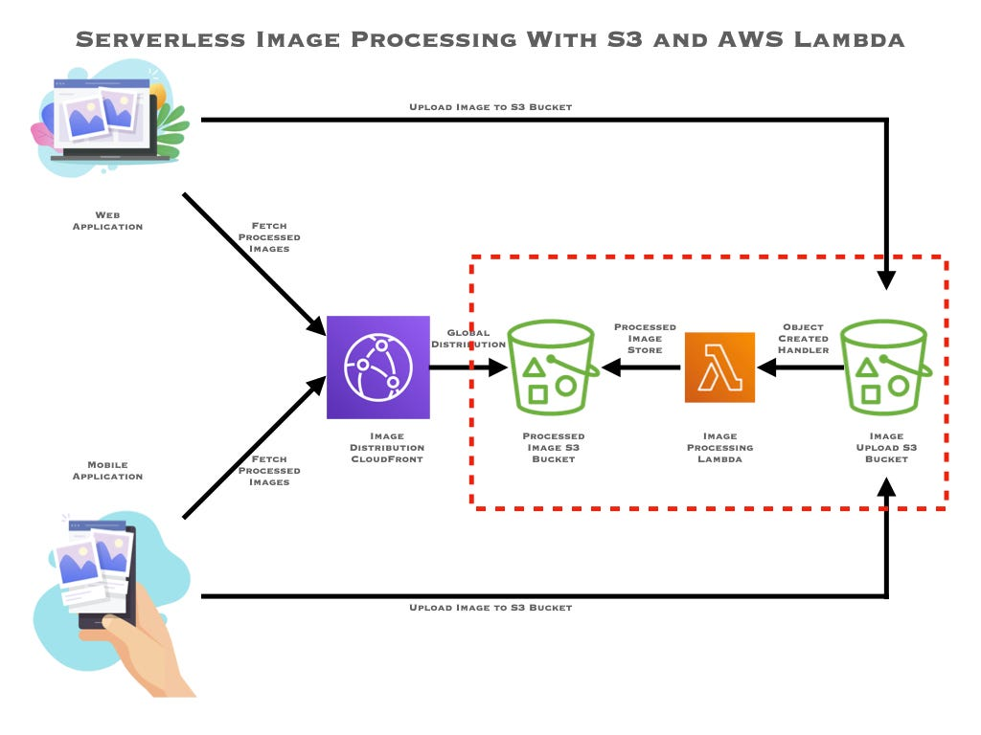

Slide 7
Image Processing Workflow
1. Image Upload: Users upload images to the S3 bucket.
2. S3 Event Trigger: S3 generates an event when an image is uploaded.
3. Lambda Invocation: The Lambda function is automatically invoked in response to the S3 event.
4. Image Processing: The Lambda function processes the image using custom logic and/or third-party libraries.
5. Processed Image Storage: The processed image is stored back in the S3 bucket or any other desired location.
6. Optional: Notification: Optionally, a notification can be sent to users or other systems upon successful image processing.

Slide 8
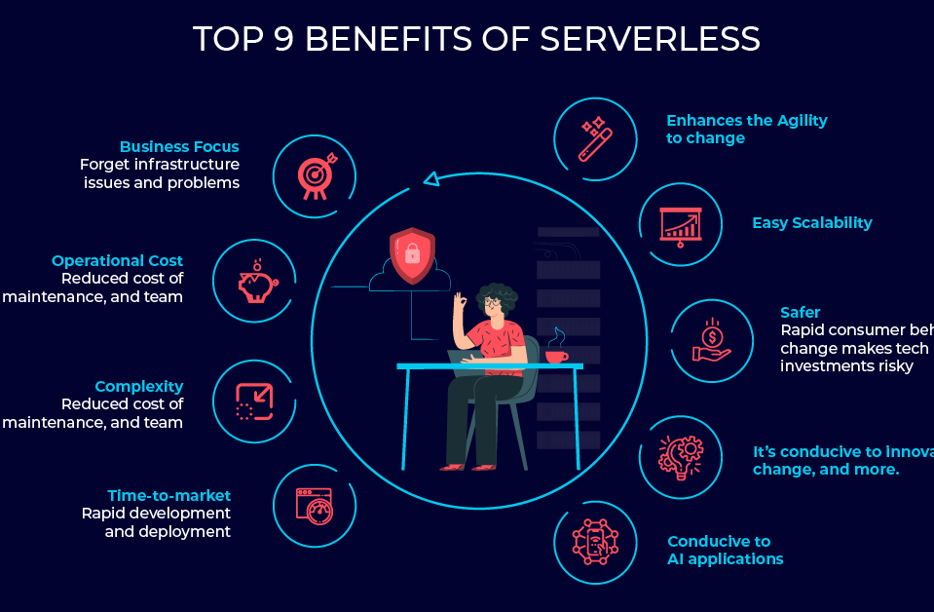
Benefits of serverless
Scalability: Serverless platforms automatically scale resources based on demand, ensuring that image resizing can handle varying workloads without manual intervention.
Cost Efficiency: You only pay for the actual processing performed, reducing costs during periods of low activity. This cost model can be more economical compared to maintaining dedicated servers.
Resource Optimization: Serverless platforms often optimize resource utilization, ensuring efficient image resizing processes.
Resource Optimization: Serverless platforms often optimize resource utilization, ensuring efficient image resizing processes.

Slide 9
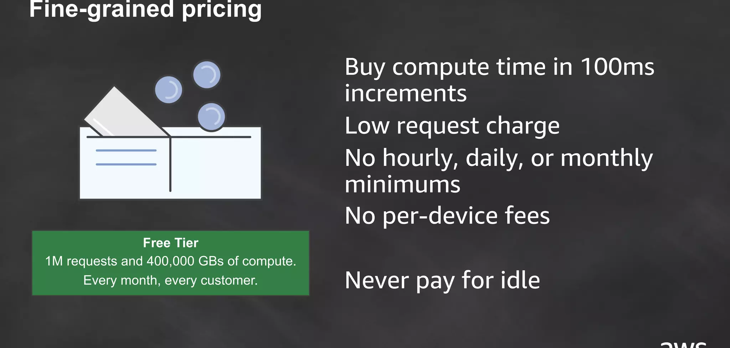

Slide 10

Conclusion
In conclusion, Serverless Image Processing in AWS using S3 and Lambda offers a powerful and cost-effective solution for handling image processing tasks. Leveraging the scalability of AWS S3 and the compute capabilities of AWS Lambda, we can build efficient and flexible workflows that process images on demand without the need for managing servers. This serverless approach enables faster development, reduced maintenance, and optimized cost structures, making it an ideal choice for various image processing applications.

Slide 11

Thank you

